Slide 1

Data Warehouse Design
Pertemuan 6
Dr. Dedi Trisnawarman

Slide 2
Datawarehouse Design

Slide 3
Methodology
Inmon
Kimball
Create data model for all
Then, used for feed data marts
Advantages:
Provide consistent and comprehensive view
Disadvantage :
Hard to be implemented on complex project
Start by identifying information requirement ( data marts )
Advantage:
Easy to handle complex project within allocated period and budget
Disadvantage :
May not provide consistent and comprehensive database

Slide 4
Phase I Create a High-Level Dimensional Model
Modelling stage by kimball
Select Business Process
Declare Grain
Choose Dimensions
Identify Facts
Phase II Identify All Dimension Attributes for the Dimensional Model

Slide 5
Online analytical processing (OLAP)

Slide 6
OLAP is The dynamic synthesis, analysis, and consolidation of large volumes of multidimensional data.
Abilities to answer “Why ?”

Slide 7
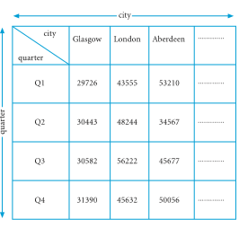
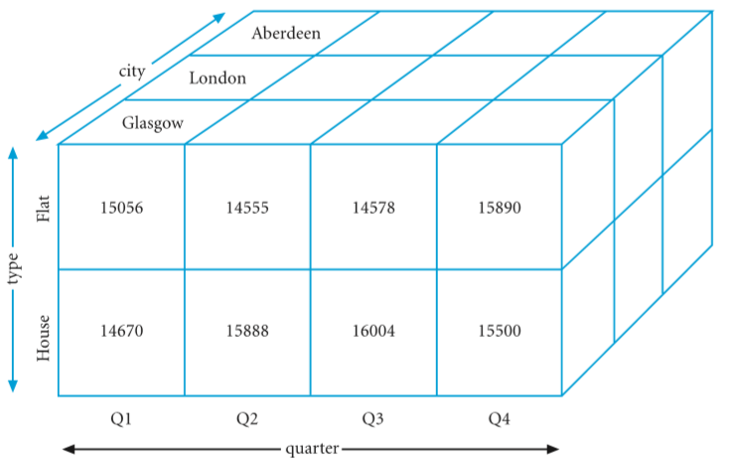
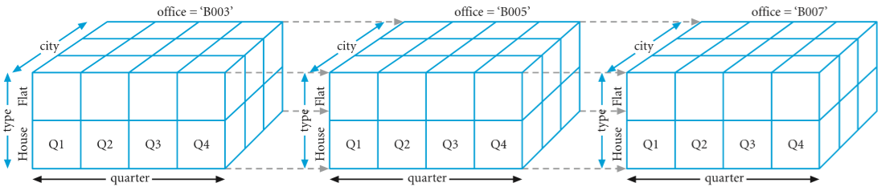
Multidimension data
Two-dimensional matrix
Three-dimensional matrix
Four-dimensional matrix

Slide 8
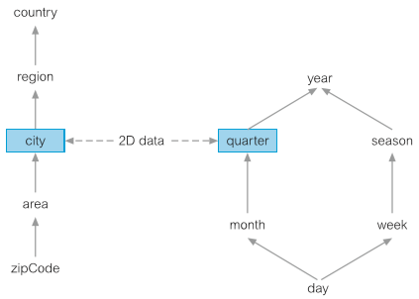
Dimensional Hierarchy
Mappings from a set of lower-level concepts to higher-level concepts.
Example : city-> province -> country

Slide 9
OLAP Server
Relational OLAP | Multidimensional OLAP
Process is fast | Process is slow
Use array to store data | Use relational table
Easy to use | Little tricky
Separate database | May not require
Relational OLAP
Multidimensional OLAP
Hybrid OLAP

Slide 10

Schema
Star schema
Snowflake schema
Fact Constellation schema
#Baca www.tutorialspoint.com/dwh/dwh_schemas

Slide 11
Codd’s Rules for OLAP Tools
Codd formulated twelve rules as the basis for selecting OLAP tools:
Multidimensional conceptual view
Transparency
Accessibility
Consistent reporting performance
Client–server architecture
Generic dimensionality
Flexible reporting
Generic dimensionality
Dynamic sparse matrix handling
Multi-user support
Unrestricted cross-dimensional operations
Intuitive data manipulation
Unlimited dimensions and aggregation levels

Slide 12
Data Mining

Slide 13
The process of extracting valid, previously unknown, comprehensible, and actionable information from large databases and using it to make crucial business decisions

Slide 14
Data mining Technique
Predictive analysis
Database segmentation
Link analysis
Deviation detection

Slide 15
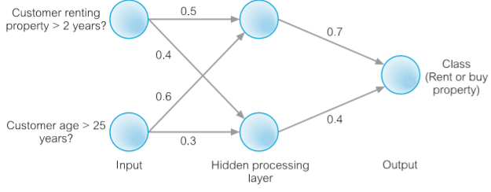
Predictive Modeling
Use supervised learning approach to forecast/predict outcome
Classification
establish a specific predetermined class for each record in a database
Value prediction
estimate a continuous numeric value that is associated with a database record

Slide 16
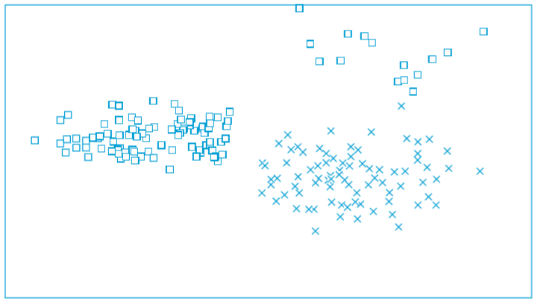
Database segmentation
Aim to clusters or categorized data by similar value

Slide 17
Link analysis
Evaluate the relationship or connection between network nodes

Slide 18
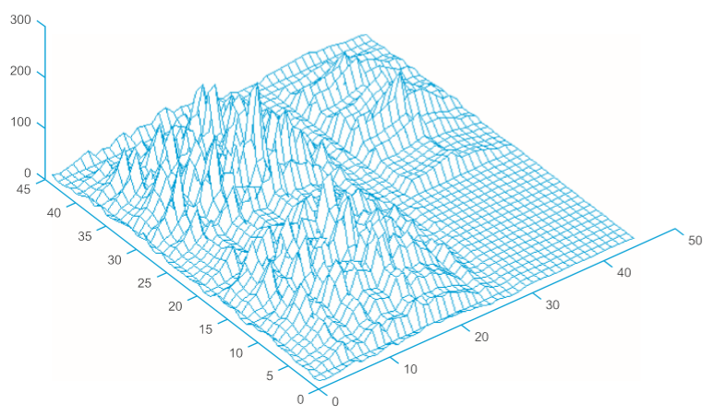
Deviation detection
Identifies outliner or anomaly
This graphic visualize 3d model of previous graphic (database segmentation)

Slide 19
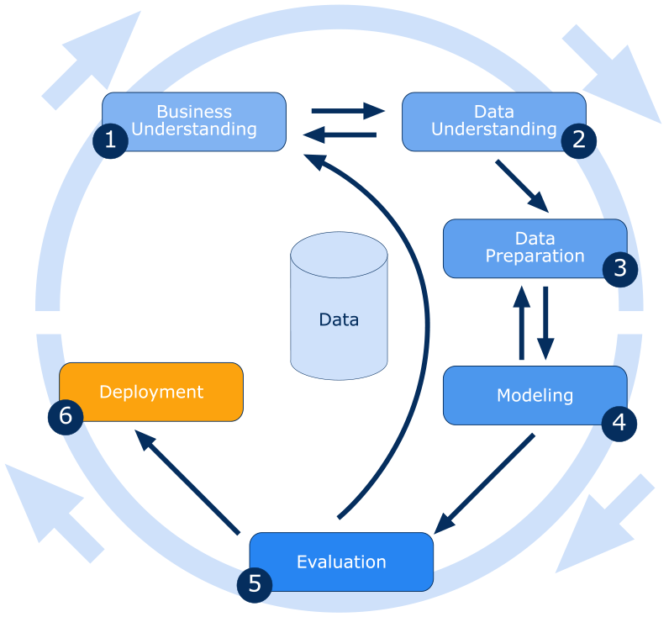
Data mining process
Cross-industry standard process for data mining ( CRISP-DM ) is an open standard process model that describes common approaches used by data mining experts.
Six major phase
Business understanding
Data understanding
Data preparation
Evaluation
Deployment
Source : https://barnraisersllc.com

Slide 20
Data mining tools
Data preparation
Data mining algorithms
Scalability and performance
Good Dashboard

Slide 21
Data Warehouse
A data warehouse is a computer system dedicated to storing and analyzing data to reveal trends, patterns, and correlations that provide information and insight. Traditionally, organizations have used data warehouses to store and integrate data collected from their internal sources (usually transactional databases), including marketing, sales, production, and finance. The data warehouse emerged when companies realized that analyzing data directly from those internal systems competed with the day-to-day activities of business users such as data entry and operational reporting.
Over the years, data sources have expanded beyond internal business operations and external transactions. They now include exponentially greater volumes of data and more complex data from websites, mobile phones, online games, online banking apps, and even machines. Most recently, companies are capturing huge amounts of data from IoT (Internet of things)-enabled devices.

Slide 22
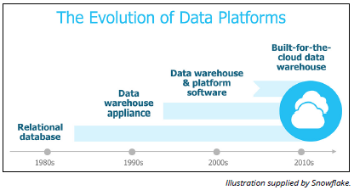
The Evolution of Data Warehousing

Slide 23
Recognizing the limitations of conventional data warehousing
Conventional data warehouse solutions were not designed to handle the volume, variety, and complexity of today’s data. And newer systems designed to address these shortcomings struggle to accommodate the data access and analysis that organizations now require. Today’s challenges reveal:
Data sources are more numerous and varied, resulting in more diverse data structures that must co-exist in a single location to enable exhaustive and affordable analysis.
Traditional architectures inherently cause competition between users and data integration activities, making it difficult to simultaneously pipe new data into the data warehouse and provide users with adequate performance.
Scaling up a conventional data warehouse to meet today’s increasing storage and workload demands, when possible, is expensive, painful, and slow.
The more recent, alternative data platforms are often complex, requiring specialized skills and lots of tuning and configuration. This struggle worsens when trying to handle the growing number and diversity of data sources, users, and queries.

Slide 24
Technology and design to the rescue!
The cloud:
A key factor driving the evolution of the modern data warehouse is the cloud. This creates access to nearinfinite, low-cost storage; improved scalability; the outsourcing of data warehousing management and security to the cloud vendor; and the potential to pay for only the storage and computing resources actually used.

Slide 25
Technology and design to the rescue!
Massively parallel processing (MPP):
MPP emerged in the previous decade, which involves dividing a single computing operation to execute simultaneously across a large number of separate computer processors. This division of labor facilitates faster storage and analysis of data when software is built to capitalize on this approach.

Slide 26
Technology and design to the rescue!
Columnar storage:
Traditionally, databases stored records in rows, similar to how a spreadsheet appears.
For example, this could include all information about a customer or a retail transaction. Retrieving data the traditional way required the system to read the entire row to get one element. This is laborious and time-consuming.
With columnar storage, each data element of a record is stored in a column. With this approach, a user can query just one data element, such as gym members who have paid their dues, without having to read everything else in that entire record, which may include each member’s ID number, name, age, address, city, state, payment info, and so on.
The approach can provide a much faster response to these kinds of analytic queries.

Slide 27
Technology and design to the rescue!
Vectorized processing:
This form of data processing for data analytics (the science of examining data to draw conclusions) takes advantage of the recent and revolutionary computer chip designs.
This approach delivers much faster performance versus older data warehouse solutions built decades ago for older, slower hardware technology.

Slide 28
Technology and design to the rescue!
Solid state drives (SSDs):
Unlike hard disk drives (HDDs), SSDs store data on flash memory chips, which accelerates data storage, retrieval, and analysis.
A solution that takes advantage of SSDs can deliver significantly better performance.

Slide 29
Introducing the cloud data warehouse
Cloud data warehousing is a cost-effective way for companies to take advantage of the latest technology and architecture without the huge upfront cost to purchase, install, and configure the required hardware, software, and infrastructure.
The various cloud data warehousing options are generally grouped into the following three categories:
Traditional data warehouse software deployed on cloud infrastructure
Traditional data warehouse hosted and managed in the cloud by a third party as a managed service
A true SaaS data warehouse

Slide 30
Traditional data warehouse software deployed on cloud infrastructure:
This option is very similar to a conventional data warehouse, as it reuses the original code base. So you still need IT expertise to build and manage the data warehouse.
While you do not have to purchase and install the hardware and software, you may still have to do significant configuration and tuning, and perform operations such as regular backups.

Slide 31
Traditional data warehouse hosted and managed in the cloud by a third party as a managed service:
With this option, the third party provider supplies the IT expertise, but you’re still likely to experience many of the same limitations of a conventional data warehouse. The data warehouse is hosted on hardware installed in a data center managed by the vendor.
This is similar to what the industry referred to as an ASP or application service provider. The customer still has to specify in advance how much disk space and compute resources (CPUs and memory) they expect to use.

Slide 32
A true SaaS data warehouse:
With this option, often referred to as data-warehousing-as-a-service, (DWaaS), the vendor delivers a complete cloud data warehouse solution that includes all hardware and software and the IT and database administration (DBA) expertise required. Clients typically pay only for the storage and computing resources they use, when they use them. This option should scale up and down on demand.

Slide 33
Why You Need a Cloud Data Warehouse
Any organization that depends on data to better serve their customers, streamline their operations, and lead their industry will benefit from a cloud data warehouse. Unlike massive, traditional data warehouses, the cloud means businesses big and small can size their data warehouse to meet their needs and their budget, and dynamically grow and contract their system as things change from day-to-day and year-to-year.

Slide 34
Why You Need a Cloud Data Warehouse
Customer experience: Monitoring end-user behavior can help companies tailor products, services, and special offers to the needs and demands of individual consumers. With customer sentiment analysis, companies understand better what customers think by analyzing their social media postings, tweets, and other online messaging.
Quality assurance: Companies can also use the analysis of customer sentiment to monitor for early warning signs of customer service issues or product shortcomings and take action sooner than was previously possible when the only data source was call center complaint logs.
Operational efficiency: Operational intelligence (OI) consists of monitoring business processes and analyzing events to identify where a company can reduce costs, boost margins, streamline processes, respond to market forces more rapidly, and so on.
Innovation: Instead of only checking the rearview mirror to understand an industry’s recent past, companies can use new sources of data to spot and capitalize on trends, thereby disrupting their industry before an unknown or unforeseen competitor does so first.

